Slide 1

Capstone Project | 2025
⚔️Model Kombat
FERTILIZER OPTIMIZER

Slide 2
MEET THE TEAM
Petina Leni
Accountant/Data Scientist
Kennedy Kariuki
Data Analyst/Data Engineer
Michael Gatero
Aeronautical Engineer
/Data Scientist
Rodgers Ndemo
Computer Scientist/Data Analyst
Raniel Musyoki
Data Scientist/Business Management Graduate
Betsy Gitije
Economist/Data Analyst

Slide 3

Business Understanding
Business Problem:
Despite a rise in fertilizer consumption across East Africa, agricultural productivity remains inconsistent and, in many cases, below expectations. This project addresses a critical challenge: how can East African nations increase agricultural output without becoming overly dependent on chemical fertilizers?
The goal is to assess whether current fertilizer usage is aligned with optimal efficiency and to evaluate its actual impact on crop productivity.
Why It Matters?
Supports sustainable agriculture
Optimizes resource allocation
Boosts food security through actionable, data-driven insights.

Slide 4
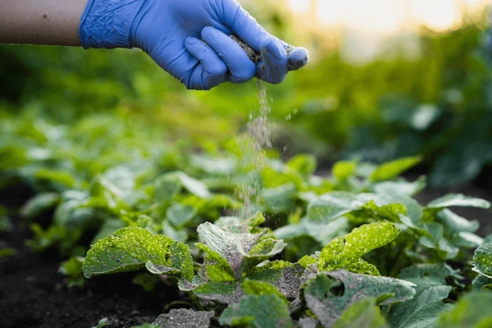
Project Objectives
Main:
Analyze fertilizer efficiency and its influence on productivity
Specific:
Track fertilizer usage trends across East Africa over time
Examine the relationship between fertilizer use and agricultural output
Forecast fertilizer consumption up to 2035
Predict agricultural productivity
Cluster countries based on fertilizer efficiency for targeted policy strategies

Slide 5
Success Metrics
Model Accuracy: 85% forecast accuracy, low prediction errors
Country Clustering: Distinct, meaningful efficiency groups
Access & Usability: Dashboards and findings fully accessible

Slide 6
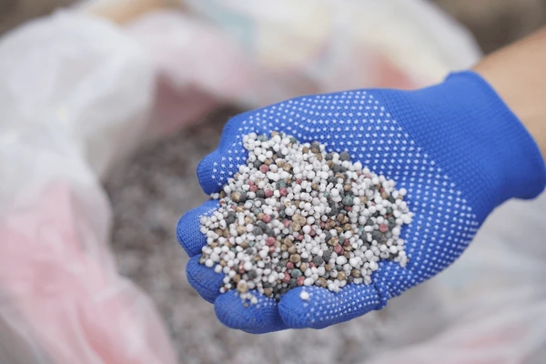
Data Understanding
Data Sources:
FAO
National Statistics
Key Observation:
Data spans 15 East African countries (1960–2023).
Includes metrics like cereal production, forest area, employment in agriculture.
Challenges: Missing data, inconsistent trends.
Key Indicators:
Fertilizer consumption (kg/ha)
Ag. value added (US$)
Employment in ag. (%)
Crop production index
World Bank Indicators

Slide 7
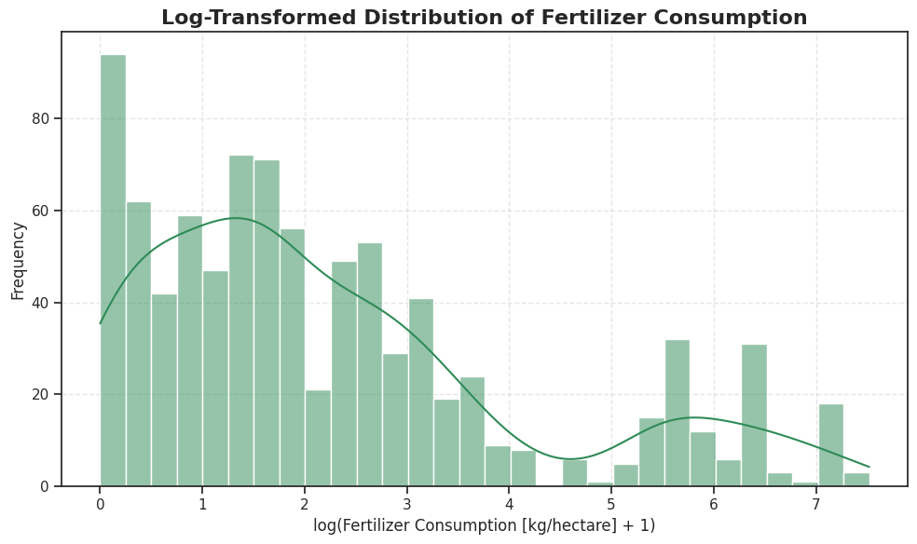
Majority of countries use low amounts of fertilizer, while a small number use extremely high amounts
Any predictive or statistical models should account for the skewness

Slide 8
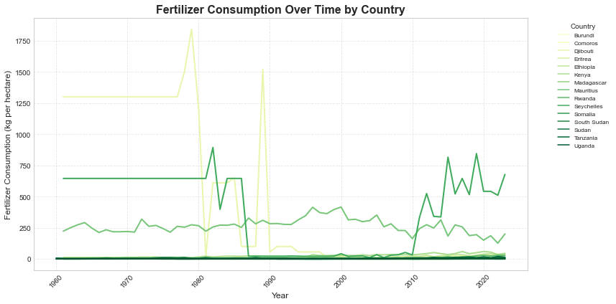
Some countries show steady growth — likely tied to productivity initiatives
Others plateau or decline — possibly due to policy, cost, or sustainability issues
Highlights the need for country-specific fertilizer and subsidy strategies

Slide 9

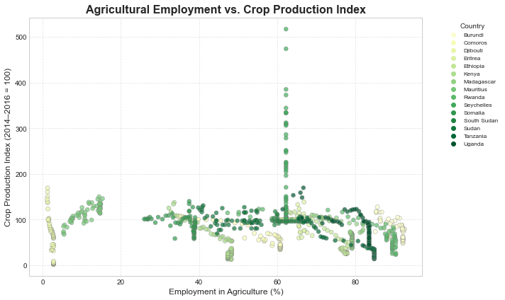
Low agricultural employment (<20%) - higher, tech-driven productivity
High agricultural employment (>40%) - stagnant or lower productivity
Outliers (~60%) show high output due to unique factors (tech, policy, environment)

Slide 10
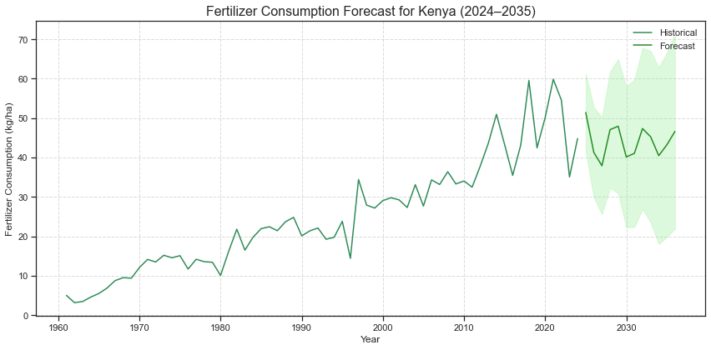
Fertilizer Consumption Trends and Forecast for Kenya (1960–2035)
Steady growth since 1960, with ups and downs— especially in recent years.
Usage is expected to level off, averaging around 40–45 kg per hectare.
Wide confidence intervals signal uncertainty — external factors like climate, prices, policy could impact actual outcomes
Good policies and support is crucial — help increase fertilizer use , boost crop yields.

Slide 11
Modeling Approach
Models Performance:
Random Forest - delivered the most accurate predictions for crop productivity, with strong explanatory power and low error
XGBoost - also performed well , but was slightly less accurate
Linear Regression - failed to capture patterns in the data likely because the relationship between features and the target is non-linear
Advanced modeling –showed non-linear relationships between variables

Slide 12
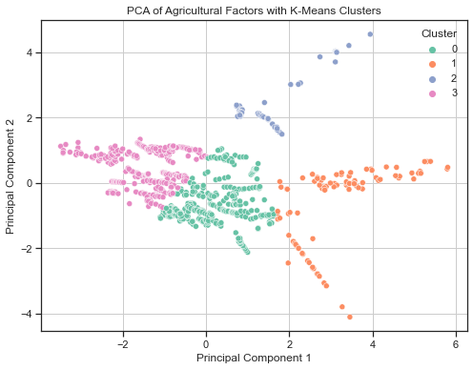
Segmenting Countries by Fertilizer Efficiency
Cluster A: High input, low output — needs efficiency improvement and waste reduction
Cluster B: Low input, high output — efficient systems to be modeled and sustained
Cluster C: Moderate input/output with high variability — requires stabilization and support
Cluster D: High input, high output — ideal for scaling through sustainable investment

Slide 13
Conclusion
This project developed a forecasting and analytics framework for fertilizer use in East Africa.
Historical and predictive analyses revealed key trends, gaps, and optimization opportunities.
Machine learning and time-series models uncovered non-linear dynamics in productivity.
Country clustering enabled more targeted and relevant policy recommendations.
Integrated, data-driven strategies are essential for sustainable agriculture and food security in the region.

Slide 14
Policy Recommendations
Increase Fertilizer Access- Build supply chains and offer subsidies to make fertilizers affordable.
Promote Sustainable Use- Train farmers on efficient, eco-friendly fertilizer practices.
Boost Cereal Yields- Invest in research, improved seeds, and irrigation.
Maximize Arable Land- Encourage crop rotation and soil conservation.
Educate Farmers- Expand extension services for modern farming knowledge.
Adopt Technology- Support precision farming, mobile tools, and AI solutions.
Build Resilience- Introduce crop insurance and emergency reserves.
Strengthen Data Systems- Improve regional data sharing and analytics.
Support PPPs- Collaborate across sectors to fund and scale solutions.

Slide 15
Who’s This For?

Slide 16
THANK YOU !
Presented By: Model Kombat
GitHub Repo: github.com/Rodgerdev/east-africa-fertilizer-project

